Slide 1
Electronic Case Reporting Data Validation and Quality Assurance in Connecticut in 2023: Use of PowerShell, XSLT, and Power Query to Improve Efficiency and Timeliness
Mike Schneider, MPH
Sue Speers, MPH
Nancy Barrett, MPH MS
Connecticut Department of Public Health

Slide 2
Disclosures
No financial interests
Not an expert
Not better

Slide 3
What's the problem?
Needs:
Testing
Data validation/ Quality assurance
Efficiency
Challenges:
Unable to use R scripts
Slow
Small team

Slide 4
Solution
PowerShell®
Power Query®
Data Faster
XSLT
* XSLT= Extensible Stylesheet Language Transformations
Notes:
PowerShell is primarily made up of a command-line shell and an object oriented scripting language, but can also be used to automate processes.
Primarily used on a windows OS, but can be used on Linux and Mac OS.
Built-in support for data formats: Handle CSV, JSON, and XML

Slide 5
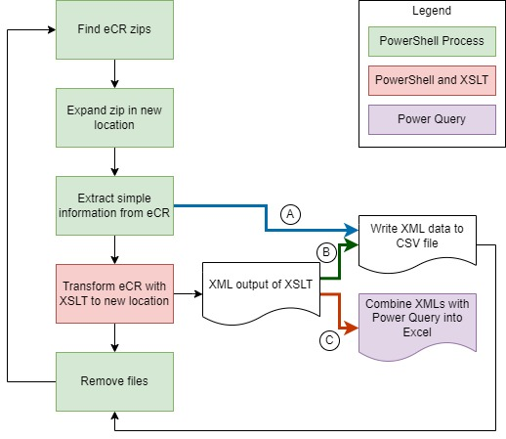
How did we do it?
Three methods used:
Pull variables from eCR to CSV
Good for simple, non-repeating elements
Transform eCR and Write to CSV
Good for elements that have the potential to repeat and can be made very specific.
Transform eCR and use Power Query® to combine output XMLs
Good for displaying repeating elements (meds, problems, etc.). Can be very specific if needed.

Slide 6
Data Validation and QA
It worked!
Able to test rules not in DQ Schematron
Compare elements across different senders
Sandbox for testing Xpaths
HCO | Count of eCRs | Number of Planned Observations | Number of Planned Procedures | Planned Observation per eCR | Planned Procedure per eCR
HCO-A | 2,497 | 23,942 | 137 | 9.59 | 0.05
HCO- B | 10,276 | 0 | 51,319 | 0.00 | 4.99
HCO-C | 104 | 0 | 863 | 0.00 | 8.30
HCO-D | 858 | 4,010 | 1,864 | 4.67 | 2.17
HCO-E | 207 | 0 | 0 | 0.00 | 0.00
Grand Total | 13,942 | 27,952 | 54,183 | 2.00 | 3.89
eCRs received from 01Jan24-01Mar24
Notes:
In 8,707 unique encounters assessed for data quality, 10.3% (903/8,707) had incorrect race codes, 4.4% (385/8,707) were missing encounter codes, 20.8% (13,254/63,723) had non-coded vaccine entries, and 3.6% (643/17,827) of trigger codes were not current. The R script used to compare speed could not create the results above because that script concatenates information into one Excel cell and is not easily analyzed. Schematron use requires processing in the eCR transformation engine that can only be run by IT staff and not by Informatics staff.
Allowed us to dive into data where the data quality schematron might not provide insights. For example, in eCRs there are two templates called the planned observation and the planned procedure. Planned observations are supposed to be ordered procedures that do not cause a change to the patient body (aka lab tests, x-rays). Planned procedures are ordered procedures that do cause a change the patient (knee replacement). In HCO B and C we are seeing no planned observations and a huge amount of planned procedures compared to other HCOs that do have planned observations. Upon further inspection, these two HCOs are populating their planned observations (lab tests) in the planned procedures template. This fact would not be readily deduced by the schematron results, because there are no errors in the planned observation template and the planned procedure template is not currently in the schematron.

Slide 7
Efficiency
PowerShell® compared to R (parsing the same elements into a CSV file)
>16X faster on the state network
>3X faster over VPN
Real Life Example:
In a 15-minute period
PowerShell® parsed 2,700-15,000 eCRs
R parsed 900 eCRs
Network
VPN
>90% of eCRs in a 3-month period

Slide 8
More than just a parser
Search for and copy specific files to a new location
Transform eCRs into extracted HTMLs for staff
Search for specific condition codes in RR
Compare SNOMED codes in eCRs to surveillance system mappings
Make your script talk

Slide 9

Conclusion
Alternative to R scripts
Validation/ QA/ Testing
Efficient and Fast
The Best Option

Slide 10
Thank You
Lynn Sosa, MD
Nancy Barrett, MPH, MS
Sue Speers, MPH
Informatics Team

Slide 11

Contact
Mike Schneider
CT Dept of Public Health
Michael.Schneider@ct.gov
Resources
https://github.com/mikeeschneider/CSTE2024

